Slide 1
2020 Recommended
Capital Plan
September 5, 2019

Slide 2
Capital Reinvestment
Proposed 2020-2024 Capital Plan provides a financial strategy to achieving net-zero emissions by 2035.
Capital Plan proposes approximately $100 million of investment over the next 15 years.
Recommends a policy change in the annual capital appropriation, by allocating 1.00% (compared to the current 0.5%) of the property tax levy to support capital investment.

Slide 3
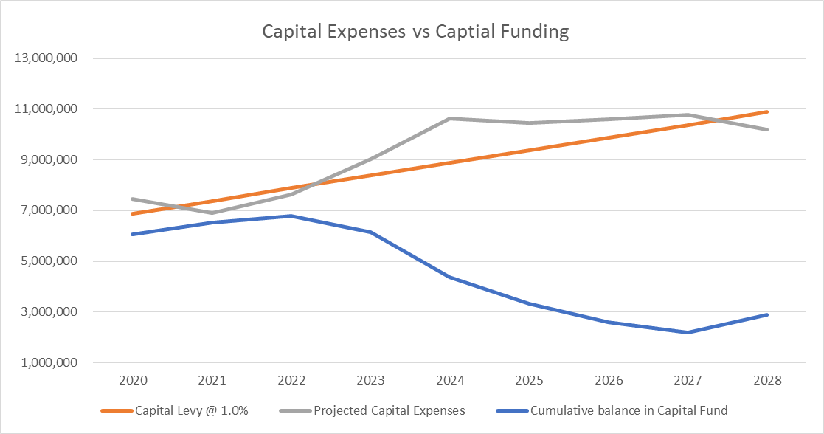
Designates $32 million for Green Facility improvements.
Assumes $22 million for downtown campus.
Additional $30 million for public safety building improvements.
$7 million committed to cover airport improvements.
$6.5 million for back up dispatch center and system upgrades.
$2 million to electrify our passenger fleet.
Cumulative balance in capital fund includes $2.5M transfer from General Fund unassigned fund balance.

Slide 4
Potential improvements include: LED lighting, building envelope sealing, plug load controls, controls optimization, boiler replacement, transformer replacement, solar canopies, geothermal, solar PV, distributed battery storage, and fuel cells.
Preliminary research suggests that such investments could achieve approximately a 90% reduction in current emissions.
New technologies and efficiencies anticipated in the next 15 years, could get the County very close to its net-zero emissions goal.
The Capital Plan includes $200,000 to hire expert consultants to assist in the detailed engineering work required to move these projects forward.
It is envisioned that planning work will occur in 2020/21 with investments commencing in 2022/23.
Green Facilities
($32M)
($4M grants)

Slide 5
Constructing a facility to house County Admin, Attorney, Finance, HR, Clerk, OHR, Planning, Assigned Counsel, ITS, Assessment, BOE.
Project include renovations of Old Jail for District Attorney’s Office, Old Court House and COFA annex.
New construction and renovations would target net-zero energy goals.
Legislature has committed $1.775M toward purchase of property.
It is envisioned that design work will occur in 2020/21 with construction commencing in 2021/22.
Est. project cost $22M. Total amount bonded $17M.
Downtown Campus
($22M)

Slide 6
Considers substantial renovations to public safety building/jail to meet new energy standards and improve operational layout.
Does not consider a new jail construction.
Currently underway with condition assessment of facility. Will be expanding scope to consider additional office/patrol construction options.
It is envisioned that design work will occur in 2020/21 with investments commencing in 2022/23.
Est. project cost $30M. Total amount bonded $30M.
Public Safety Building
($30M)

Slide 7
Of the three major planning initiatives the Public Safety Building is least developed at this time.
Plan provides flexibility between projects.
Financing of $84M of project costs:
  $75M = bonded
  $5M = cash
  $4M = grants
Diligent planning will be critical to implementing successful, on budget projects.
  Strategic investments
  Managing resources – financial and personnel
  PATIENCE and MOTIVATION are the keys to success.
Major Capital Planning Initiatives

Slide 8
Considers development of backup dispatch center and system upgrades ($4.75M/$2M = $6.75M)
Microwave upgrade = $1.8M
Repair & Replacement = $550k
All projects are expected to be covered by State Interoperable Communications Grant ($700k annually). No local cost.
It is envisioned that planning/design work dispatch center and system upgrade will occur in 2020/21 with investments commencing in 2022/23.
Microwave upgrade will begin in 2020.
Repair & Replacement take place over 2020-2024.
Emergency Response
($8.8M)

Slide 9
Considers electrifying 70 passenger vehicle fleet.
Recommends making $400k each year from 2021-2025.
Provides funding for replacing 12-15 vehicles annually and includes construction of charging stations.
Would make initial replacement of passenger fleet; future replacements would be done with normal budget process.
It is envisioned that planning occur in 2020 with investments commencing in 2021.
Planning work may include updating Green Fleet Policy (#9-44) and review of fleet management strategies.
Est. project cost $2M. Total project amount will be paid in cash with capital contribution.
Green Fleet
($2M)

Slide 10
Considers investing approx. $1.4 over the next 5 years in various IT infrastructure needs related to keeping our network reliable.
Equipment replacements include servers, data storage, cameras, UPS and network components.
Equipment has reached or will reach life expectancy at the time of replacement.
Core infrastructure supports 17 buildings and 27 departments.
Est. project cost $1.4M. Total project amount will be paid in cash with capital contribution.
ITS Infrastructure Replacement
($1.4M)

Slide 11
Considers the continuation of 10-year highway rehabilitation, reconstruction and maintenance plan.
Provides for a subsequent 5-year round of funding.
2020-2023 @ $1.8M; 2024 @ $2.4M
Est. project cost $9.6M. Each year is bonded with 10-year bonds.
Highway & Bridge Improvements
($9.6M)

Slide 12
Intended to address backlog of deferred maintenance of existing facilities.
Continuation of prior facility restoration efforts that included $4M of investment from 2014-2019.
Proposed capital plan includes $5.6M of investment from 2021-2027 into existing facilities. $1.4M every other year starting 2021.
Some of the expected improvements may be partnered with Green Facilities initiative.
Est. project cost $5.6M. Each year is bonded with 10-year bonds.
Facility Restoration
($5.6M)

Slide 13
$37 million terminal renovation & expansion
  $14.2 million State grant
  $12 million FAA
  $1.4 million (CDBG, NYSERDA, Property sale)
  $10 million locally bonded
Est. $3M in Passenger Facility Charges (PFCs)
  May increase with ITH activity and federal changes
$7M has been included in Capital Program as local cost
Operations remain flexible with upcoming changes
  Customs facility online, airline changes, new flights
Est. local cost $7M. Seeking State for 25-year bonding authority. Future PFC increases would decrease local share.
Airport Terminal Expansion
($37M)

Slide 14
Fund Balance Policy Update
Fund balance in the general fund should take into account a government’s own unique circumstances.
Governments that may be vulnerable to natural disasters, volatile revenue source, or potentially subject to cuts in state aid and/or federal grants.
These factors should be taken into consideration when considering the appropriate fund balance policy in order to be prepared for changes in financial condition.
Fund balance policy should include enterprise funds as well.

Slide 15
Fund Balance Policy Update
Current policy is 10% of budgeted GF revenues = $19M
GFOA recommends, “at a minimum, that general-purpose governments, regardless of size, maintain unrestricted budgetary fund balance in their general fund of no less than two months of regular general fund operating revenues or regular general fund operating expenditures.” = $31M
Median Aa1 Counties in NYS = 21.6% & Median Aa1 Counties in US = 31.1%
Recommend change general fund balance policy to 18% of budgeted GF revenues = $34M

Slide 16
Fund Balance Policy Update
Fund balance projecting is subject to change – a snap shot in time.
Assumptions do not consider current year end results.

Slide 17
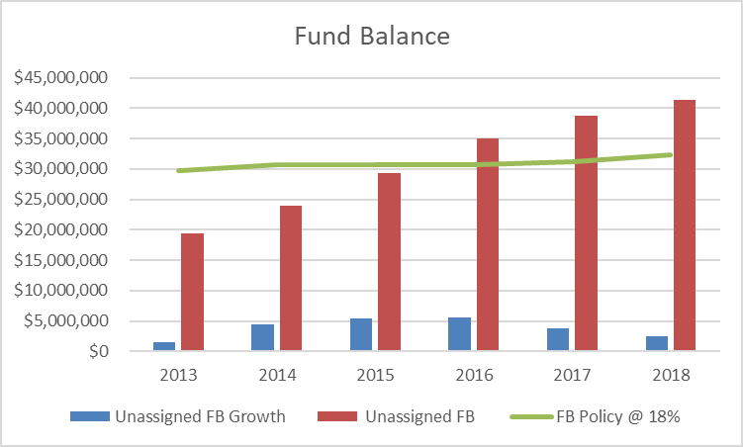
Fund Balance Policy Update
Average annual growth in unassigned FB since 2013 = $3.98M.
Growth slowing in past two years.

Slide 18
