Slide 1
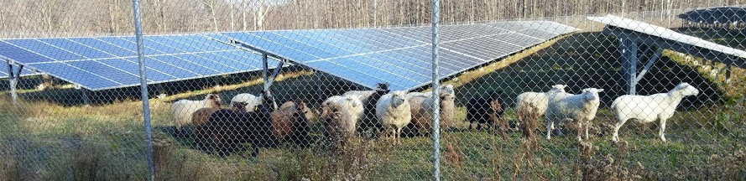
Ewe Too Can Sustainably Manage Solar Farm Ground Cover
Caleb Scott, Owner Scott Land & Yard Farm and CEO Scott & Crispell Inc.
Sarah Zemanick, Director Cornell Sustainability

Slide 2



Who We Are

Slide 3
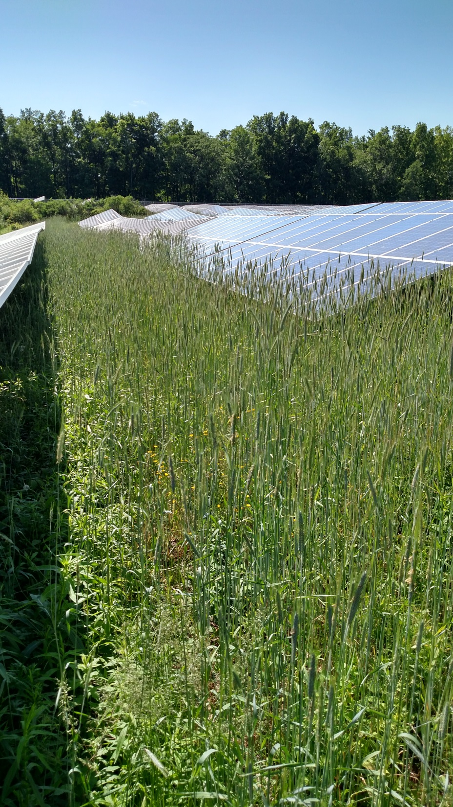
Before Sheep
vegetation shading the panels
costly maintenance
tight corners
specialty equipment
high carbon output
herbicides

Slide 4
The Task
Reduce carbon foot print
Lower costs
Build sustainability
Stimulate local economy

Slide 5
The Idea
Use sheep to reduce maintenance costs and carbon foot print
The sheep will eat the grass down browse the volunteer woody plants like honey suckle or small trees
The sheep will create a healthy eco system fertilizing the sub soil and disturbed areas
The sheep will remove the need for herbicides
The sheep will repurpose the land and add a local free range food source

Slide 6
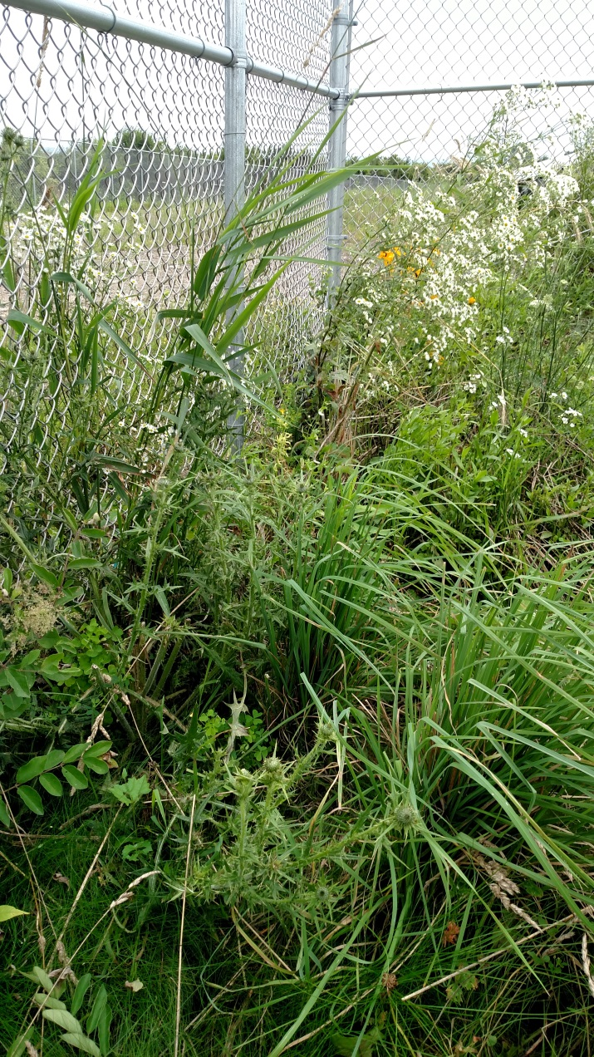
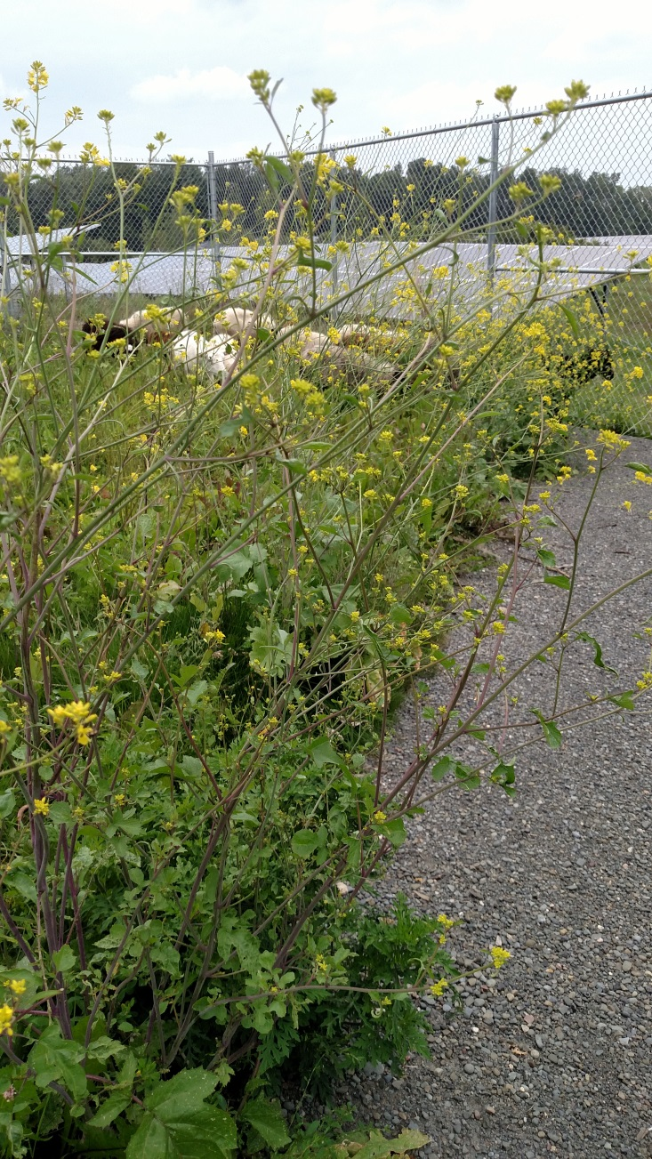

Sheep Solar Farm Trial Day 1

Slide 7
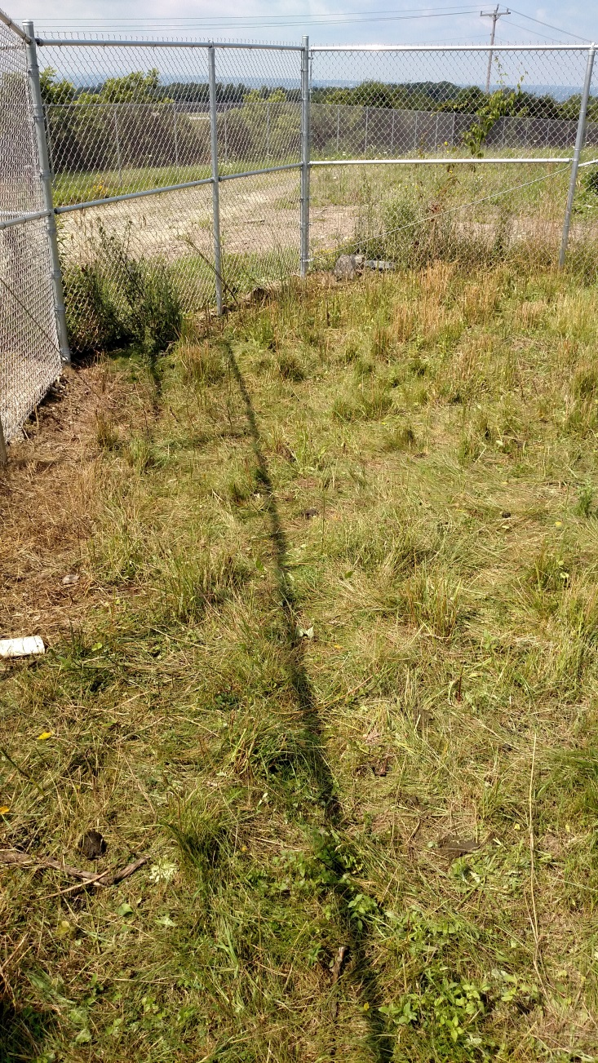
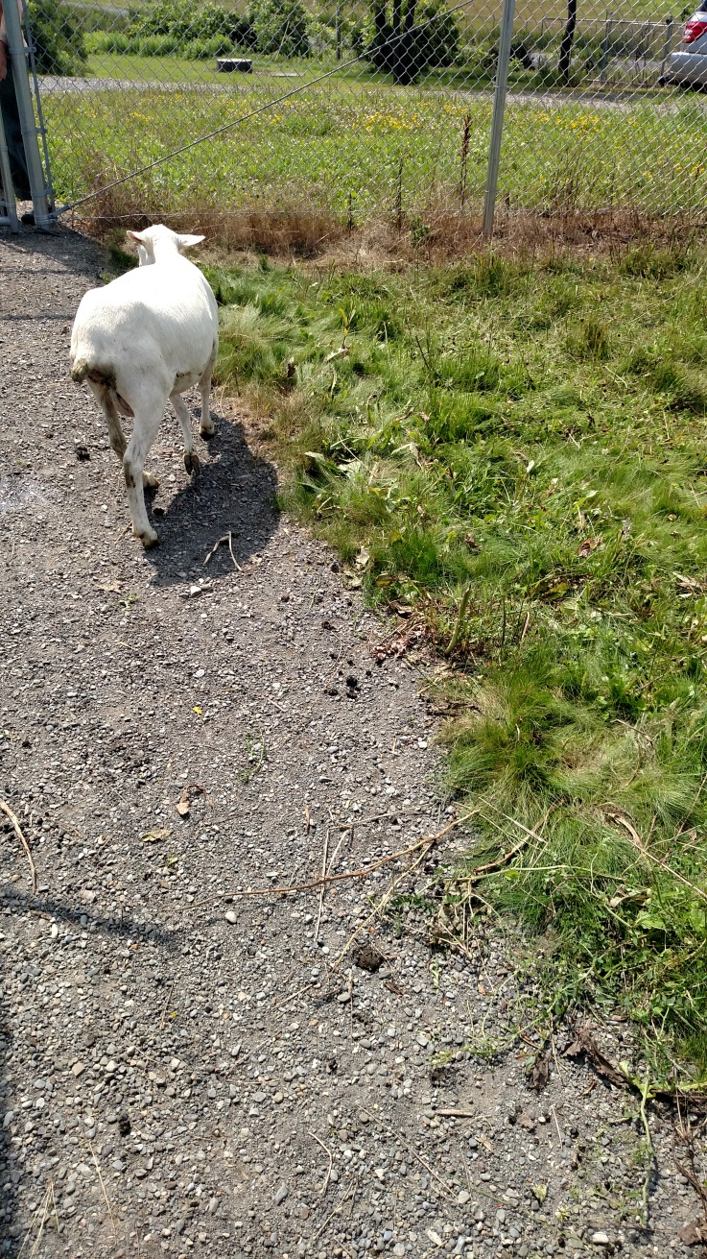

Sheep Solar Farm Trial Day 2
Just 24 hours later!

Slide 8
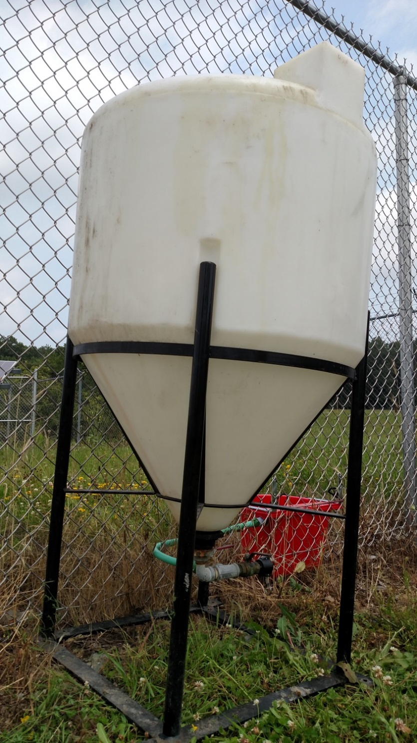
Watering System

Slide 9
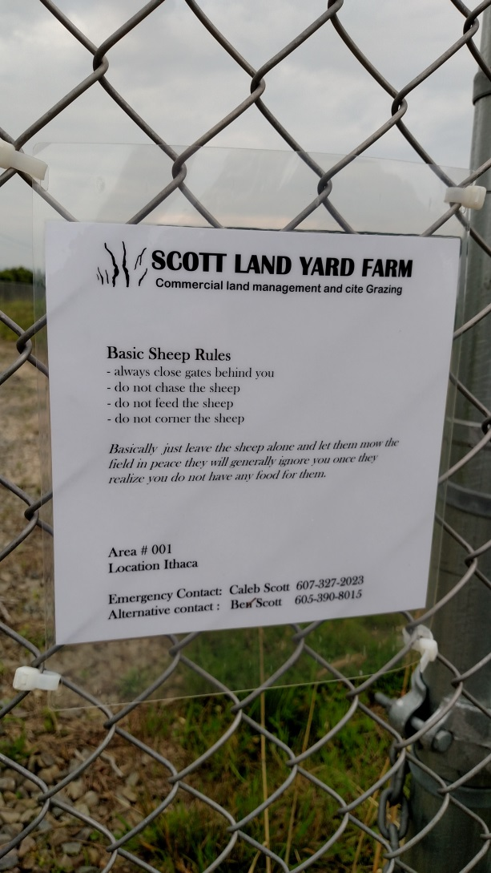
Laminated Sign
SCOTT LAND YARD FARM
Commercial Land Management and Site Grazing
Basic Sheep Rules
- always close gates behind you
- do not chase the sheep
- do not feed the sheep
- do not corner the sheep
Basically just leave the sheep alone and let them mow the field in peace; they will generally ignore you once they realize you do not have any food for them.
Area # 001
Location Ithaca
Emergency Contact: Caleb Scott 607-327-2023
Alternative contact : Ben Scott 605-390-8015

Slide 10
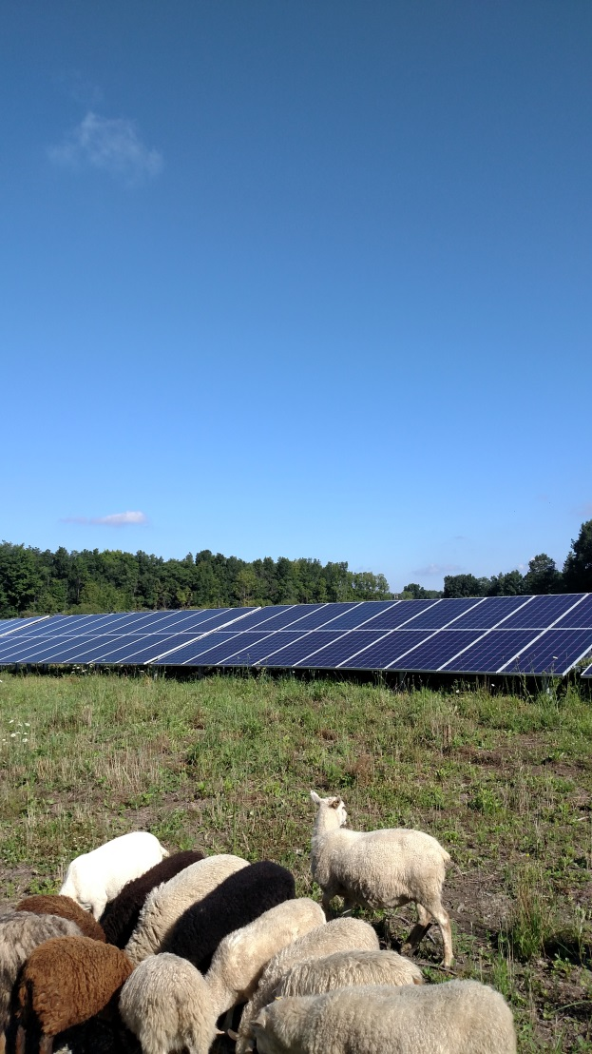
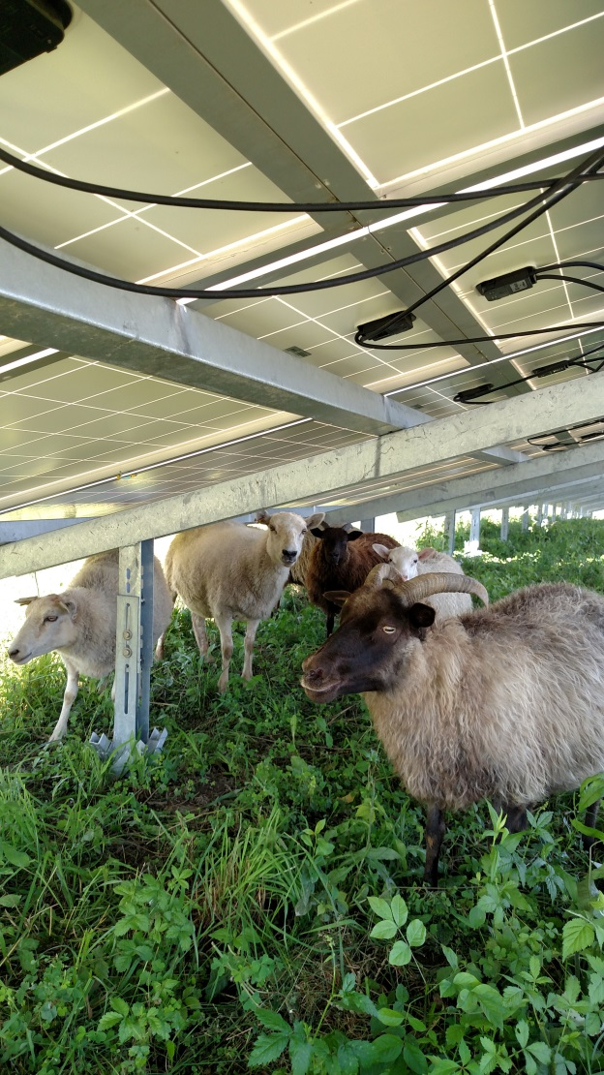
Successful Venture to the Solar Farm
Hard at work in the shade
Mowing the open field

Slide 11
Benefits of Sheep and Solar
Easy to maintain
Provide milk, wool, and meat to community
Don’t jump, climb, or chew like goats
Can easily fit under the solar panels
Can use the panels for shade and cover
Eat grass, weeds and woody plants
Are calm and friendly

Slide 12
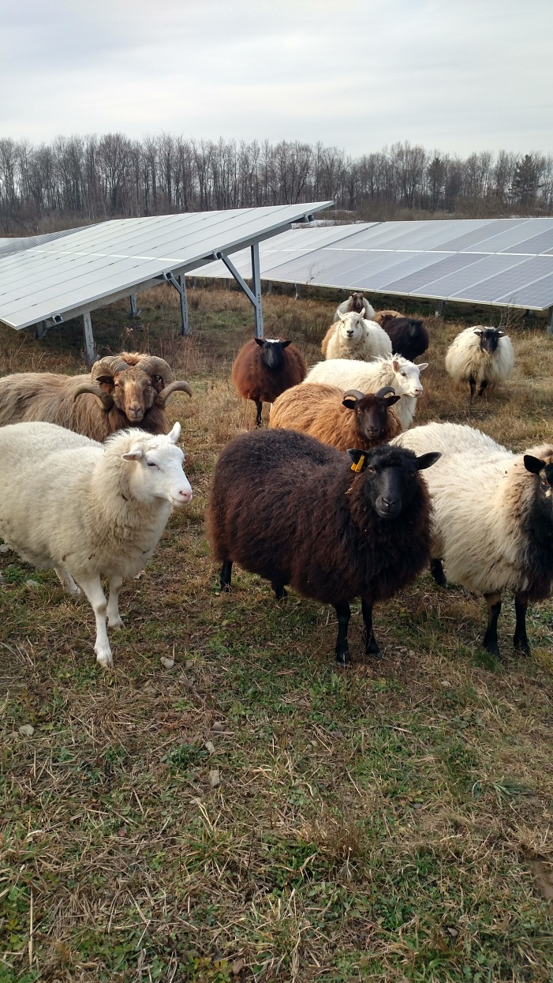
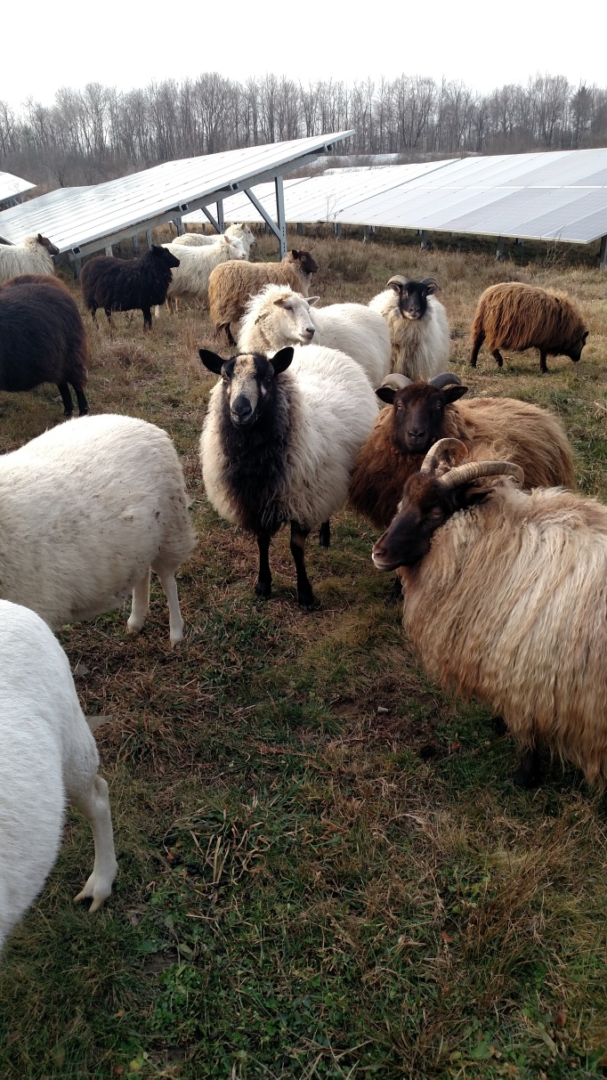
First Successful Season

Slide 13
The Goal
Make it standard acceptable practice for collages, municipalities, and government agencies to introduce sheep to their solar farms
Bring awareness to the benefits of using sheep to maintain solar areas

Slide 14
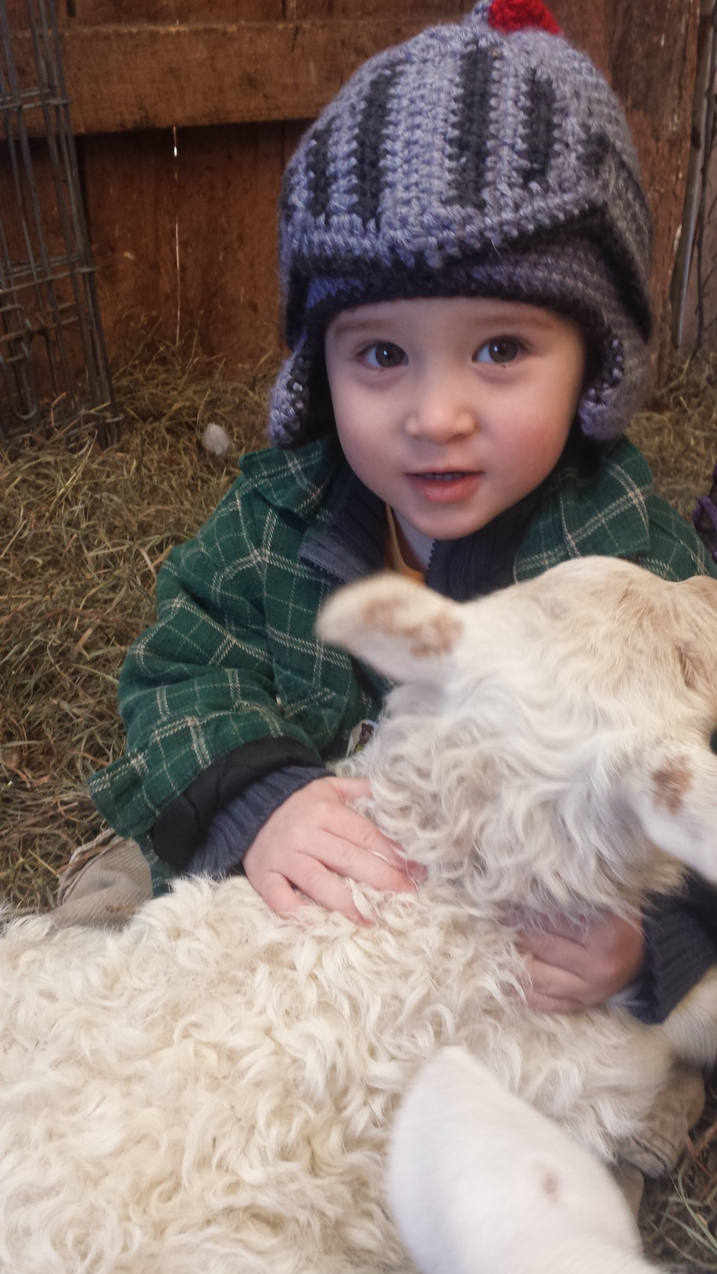
Happy Farmer
Win for Cornell
Win for Building Energy

