Slide 1
Understanding PrEP
New York State Department of Health AIDS Institute
June, 2014

Slide 2
Objectives
Learn about PrEP and how it works
List reasons why gay men and trans people should know about PrEP
Learn about PEP and how it is different from PrEP
Identify resources that are available to help you educate others about PrEP and PEP

Slide 3
Breaking down the word
PRe – meaning BEFORE
Exposure – activity that can lead to HIV infection
Prophylaxis – meaning protection
Protect yourself BEFORE your are exposed

Slide 4
PrEP is HIV prevention
An HIV uninfected gay men
who engages in risk for HIV
takes one pill once a day
to prevent him from becoming infected

Slide 5
What is PrEP?
PREP is part of a comprehensive approach to preventing HIV that includes:
Taking one pill (Truvada) once every day
Regular HIV testing
Condom use to avoid STIs
Education about safer sex practices and options
Frequent screening for sexually transmitted infections

Slide 6
Common Examples of Pre-Exposure Prophylaxis
A woman taking birth control pills to prevent pregnancy
A traveler taking anti-malaria medications when going to an area where there is high likelihood of exposure to malaria
A person taking antibiotics prior to dental surgery to prevent infection
A person with HIV taking certain medications to prevent an opportunistic infection

Slide 7
Who should have access to PrEP?
PrEP is only for people who are HIV negative
People living with HIV should not be on PrEP
They should be evaluated for HIV treatment
If someone on PrEP becomes infected, he should stop taking PrEP and make a medical appointment ASAP

Slide 8
Who should have access to PrEP?
Gay men / trans people who have unprotected anal intercourse
People in a sexual relationship with a partner who has HIV
Male-to-female and female-to male transgender individuals engaging in high-risk sexual behaviors
People who trade sex for money, drugs or housing
People who inject drugs or who share injection equipment
People who use stimulant drugs associated with high-risk behaviors, such as methamphetamine
People who had more than one STD in the last year
People who been prescribed multiple courses of non-occupational post-exposure prophylaxis (nPEP)

Slide 9
How can someone get PrEP?
Must be prescribed by a medical provider
Physician
Nurse practitioner
Physician assistant
Often delivered by a team that might also include prevention specialists, HIV testers, CBOs
How do I find out who prescribes PrEP in my area?

Slide 10
Medical Appointments for PrEP
Initial Appointment: HIV testing; PrEP is provided for only 30 days
One Month Follow-Up: Provider assesses person’s experience on PrEP including adherence, side effects and commitment. At this visit a prescription for 60 days may be given;
Three Month Follow-Up: HIV testing and other assessments; prescription for 90 days if HIV negative and adherent;
Every Three Months: HIV testing and other assessments repeated every three months; prescription for 90 days if HIV negative and adherent.

Slide 11
Paying for PrEP?
Medicaid
If a person has Medicaid, it will cover the medication
Private Insurance
Most insurance plans cover the medication. You may have co-pays
Patient Assistance
Drug manufacturer may provide financial assistance

Slide 12
You have to take the medicine for it to work!!!
Adherence | Don’t stop and start | What if I want to stop?
You have to take the medication every day for it to work Missing doses increases the chance of infection | It is not known how long before or after an exposure you have to take PrEP. Continuity and consistency = protection | Talk to the provider who prescribed PrEP for you

Slide 13
Breaking down the word
Post – meaning AFTER
Exposure – activity that can lead to HIV infection
Prophylaxis – meaning protection
Protect yourself AFTER your are exposed

Slide 14
POST Exposure Prophylaxis
HIV uninfected gay men
just exposed to HIV
(condom breaks)
starts medication within 2 hours and takes it for 28 days after the exposure
to prevent becoming infected with HIV

Slide 15
Comparing PrEP and PEP
What’s the Same?
Both PrEP and PEP use medication to prevention HIV infection
Available from a medical provider by prescription
There are resources to help pay for the medicine
Effective only if taken consistently
What’s different?
PrEP is started BEFORE and PEP is taken AFTER the exposure
Different medications
PrEP requires on-going HIV testing and additional prescriptions

Slide 16
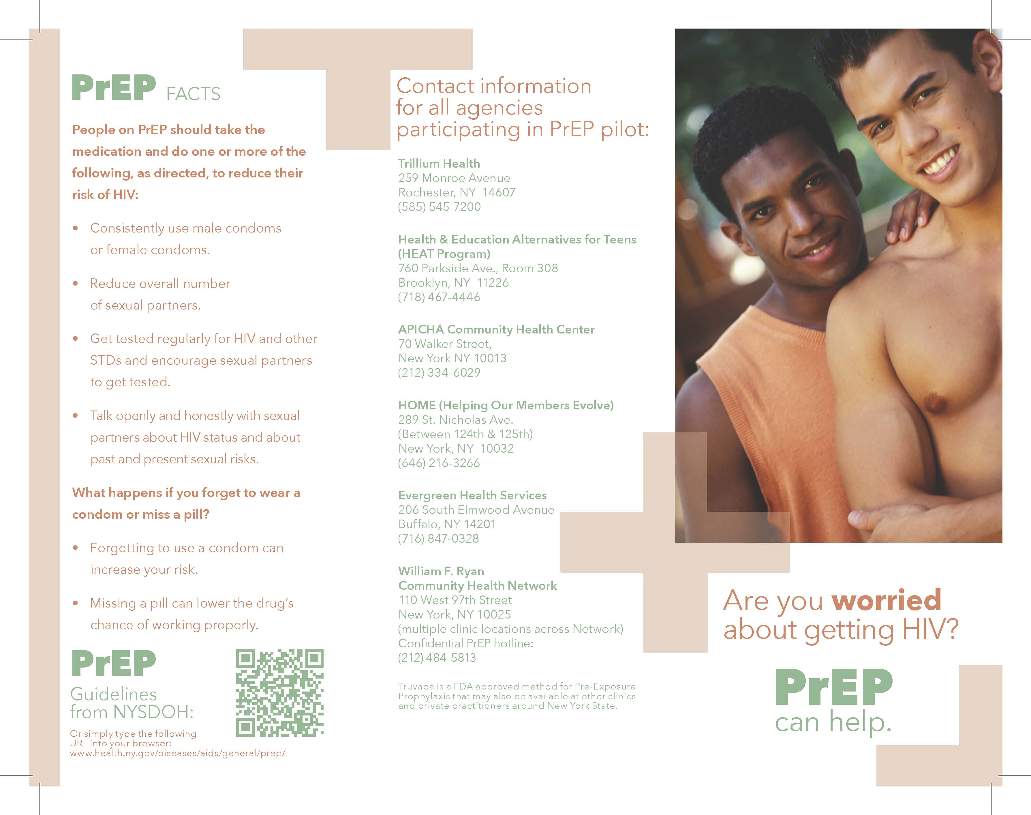
Resources

