Slide 1
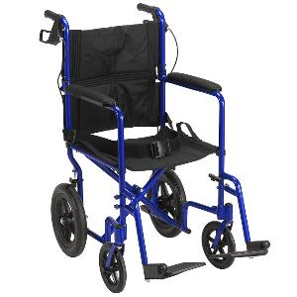
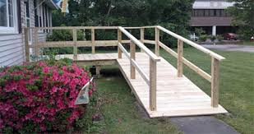

What does accessibility mean to you?
(Spinlife, n.d.; RAMPS, n.d.; The Accessible Icon Project, n.d)
Notes:
Most often: physical disabilities such as w/c bound individuals needing ramps and handicapped parking
But our study found that accessibility reaches so far beyond that:
Barriers to both physical and social environments (transportation, familiarity, etc)
Common barriers to aging process

Slide 2
Older Adults’ Perceptions on the Accessibility of Ithaca Businesses
Vincent Albano, Kaitlyn Boepple, Rachel Houseman, Jacquelyn Reyes, Janelle Smith
with faculty advisor Dr. Lynn Gitlow
Notes:
Good afternoon everyone! We are five graduate occupational therapy students here at Ithaca College and have spent the last year conducting research about older adults perceptions on the accessibility of Ithaca businesses through the assistance of our wonderful faculty advisor Dr. Lynn Gitlow.

Slide 3
Introduction
What drove our research?
  Prior research study focused on business owners’ perceptions on accessibility (Borrie, Crenshaw, Jasinski, Rosenblum, & Vandervort, 2015)
  Our focus changed from business owners to older adults
Notes:
Our topic is based off the prior study done by last years OT students, which focused on ten businesses in Ithaca. They aimed to determine business owner’s perception of accessibility and their level of awareness with the Americans with disabilities act, also known as the ADA, which is the legislation that regulates the public built environment. Our research study focused on investigating older adult perceptions of those same ten Ithaca businesses in order to gain more information on possible physical and social environmental barriers consumers may face.

Slide 4
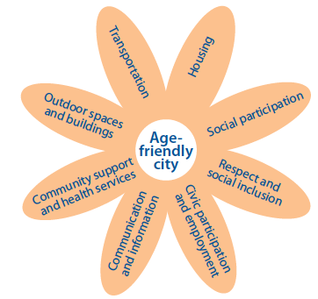
Age Friendly Initiative
Established by the World Health Organization (WHO)
A global proposal to make communities more accessible for older adults
Promotes healthy and active aging
Improves quality of life for older residents
Ithaca is working to be an Age Friendly
community following the WHO’s proposal
(World Health Organization, 2007)
(“Toward an Age-Friendly World,” n.d.; “AARP Network of Age-Friendly Communities,” 2014)
Notes:
The world health organization, also known as WHO, established the age friendly initiative, a global proposal to make communities more accessible for older adults. This recent movement has dedicated itself to advocating for accessible, inclusive, safe and supportive communities for older adults to promote healthy and active aging. This will improve their quality of life by enabling them to continue participating in meaningful activities outside the home and stay connected to people and places that are important to them.

Slide 5
Definitions
Accessibility
  ADA defines it as “a site, facility, work environment, service, or program that is easy to approach, enter, operate, participate in, and/or use safely and with dignity by a person with a disability” (Job Accommodation Network, n.d.).
  WHO and AARP - 8 global domains: (World Health Organization, 2007)
    Outdoor spaces & buildings
    Transportation
    Housing
    Social participation
    Respect & social inclusion
    Civic participation & employment
    Communication & information
    Community support & health services
Notes:
Accessibility has many different definitions based on who is defining it, but most often people think of the ADA’s definition which states it is a building that is easy to approach, enter, operate, participate and/or use safety and with dignity by a person with a disability. The WHO and the American Association of Retired People, or AARP, defines an accessible community as these 8 global domains:
Outdoor spaces & buildings
Transportation
Housing
Social participation
Respect & Social inclusion
Civic participation & employment
Communication & Information
Community support & health services
Our research was initially focused on the outdoor spaces and buildings domain, however, other themes emerged as we found it difficult to separate these 8 domains and only focus on one, which will be discussed more later.

Slide 6
Definitions
Older Adult
  Ages 60 and older (Office for the Aging, 2015).
Built/physical environment
  “Natural and built nonhuman surroundings and the objects in them. This includes things such as buildings, furniture, tools, and devices” (American Occupational Therapy Association, 2014).
Social environment
  Relationships with and expectations of persons, groups, or populations with whom the client has contact with (American Occupational Therapy Association, 2014).
Large vs. small business
  Chain vs. local single entity (Borrie, Crenshaw, Jasinski, Rosenblum & Vandervort, 2015).
Notes:
Since our research is centered around older adults we had to first determine how we would define this age group. We define older adults as people sixty years or older in order to parallel the work of the Ithaca age friendly initiative.
We define the built or physical environment as natural and built nonhuman surroundings and the objects in them. This includes things such as buildings, furniture, tools, and devices
We define the social environment as relationships with and expectations of persons, groups, or populations with whom a person has contact with.
Lastly, we define large businesses as chains and small businesses as ones that are single and locally owned.

Slide 7
Literature Review
Population is aging!
  The U.S. has reached a population of over 50 million older adults for the first time in history (“The Growth of the U.S. Aging Population,” 2016).
Environmental impact on engagement
  Poor environmental factors such as rough sidewalks, puddles, poor drainage, and narrow curb ramps can hinder older adults ability to participate (Rosenburg, 2012; Clarke & Gallagher, 2013; Bendixen et al., 2005).
  Environmental factors contribute to older adults’ fear of falling (Clarke & Gallagher, 2013).
Notes:
Our population today is aging! The OA population is one of the fastest growing demographics today reaching over 50 million for the first time in US history. A continued surge is expected over the next few decades.
A person’s environment has a huge impact on their community engagement. Things like rough sidewalks, puddles, poor drainage, and narrow curb cuts have been shown to hinder OA’s ability to fully participate. These environmental factors also contribute to a fear of falling, which further inhibits an older adults engagement in their community.

Slide 8
Literature Review Continued
Working towards an Age Friendly Ithaca (“Ithaca Census,” n.d.; Horn, 2012)
  Ithaca demographics High prevalence of arthritis, high blood pressure, and eye problems
  Other common health conditions reported such as hearing problems, heart disease, foot problems, and osteoporosis
Business owners’ perceptions on accessibility (Borrie et al., 2015)
  Familiarity with the ADA 5.85/10
  Accessibility of business 8.4/10
  1.3 examples of problems they notice older adults face
Notes:
Ithaca, located in Tompkins county, is working towards becoming an age friendly community as its 60 and older population exhibited a 34% growth from the years 2000-2010. A needs assessment survey of Ithaca’s 60 and older population was done in 2012 by Tompkins county office of the ageing. This survey revealed that over half the participants reported having arthritis, high blood pressure, and eye problems. A quarter reported having hearing problems, heart conditions, and foot problems. All of these normal aging issues impact a persons ability to fully engage in their community and is a reason why communities need to think about accessibility for all ages.
In order to begin investigating the built domain here in Ithaca, last years research looked at business owners perceptions of the accessibility of their business. Although business owners identified their familiarity with the ADA as low, they still rated their businesses accessibility high according to those ADA standards. This revealed a discrepancy between their knowledge and perceptions of accessibility. These business owners seemed to focus solely on physical accommodations for wheelchair users rather than OAs in general, a trend we also ran into while looking into the current research. When asked about common problems they notice OAs encountering in their business an average of 1.3 problems were identified, yet over half of the owners reported there was nothing they would change in order to increase the accessibility of their business.

Slide 9
Purpose
The purpose of this study is to gather older adults’ perceptions on the accessibility of Ithaca businesses
Ithaca and Tompkins County are working to become age friendly
Notes:
The purpose of this study is to gather older adults’ perceptions on the accessibility of Ithaca businesses. Our research came about because of the lack of understanding about the older adult consumers perspective, which is important for communities with an aging population who are regularly engaging in those businesses. Ithaca is working to become age friendly and our results will be given to the Ithaca age friendly initiative to help make the a welcoming and accessible community for all ages.

Slide 10
Research Questions
How do older adults perceive the accessibility of Ithaca businesses?
  Is there a difference in older adults’ perception of accessibility in small versus large businesses?
What changes, if any, can older adults recommend to businesses in order to make them more accessible?
What types of barriers (physical and social) do older adults identify in local businesses?

Slide 11
Method: Research Design
Study was approved by the Ithaca College Institutional Review Board
Qualitative Research (Krueger, 1994)
Focus Groups (Krueger, 1994)
Snowball Sampling and Recruitment Methods
Notes:
Before we began the Ithaca college institutional review board approved our study.
This research used a qualitative research design that incorporated focus group interviews. This design type allowed our participants to articulate their experiences, opinions, and perceptions of the businesses they visited without being restricted to predetermined barriers or facilitators. Overall, this design type gives us a deeper perspective than can be gained via survey research.
Participants were recruited via snowball sampling a method used when participants are difficult to obtain. It occurs by having the initial subjects provide names of others who may meet the study criteria. Flyers, newsletters, and general announcements were distributed with the help of both IC faculty and activity directors of a few local facilities including Titus Towers, Lifelong, Longview, Kendal, and the Greater Ithaca Activities Center.

Slide 12
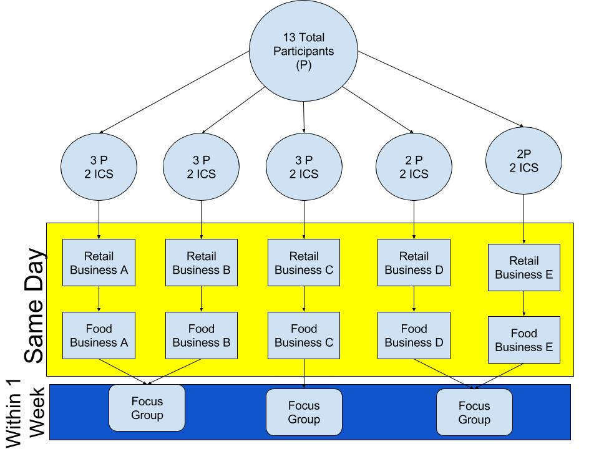
Method

Slide 13
Method: Procedure
Took each group of participants out into businesses from previous research
  One retail-shopping related
  One food related
Participant engaged in focus group within one week of the outing
Transcription and notes of focus groups
Transcriptions and notes coded by multiple researchers to identify themes
Notes:
2-3 graduate students were pre assigned to accompany each group out into the community. All ten businesses from last year’s research were visited, with each group visiting two of them, one consisting of a retail shopping service and the other a food service.
Within the following week each participant engaged in one of three focus groups to discuss their experience and thoughts on the businesses accessibility. Each focus group was both audio and video taped, and researchers also took handwritten notes. Those audio and video files were transcribed and then coded in order for the researchers to identify major themes.

Slide 14
Results: Participant Demographics
Total participants: 13
Male | 2
Female | 11
Caucasian | 8
African American | 5
Notes:
Rachel
Our total number of participants was 13, with the majority identifying as female. We were able to engage with both caucasian and african american older adults, which allowed us to understand a broad range of perspectives regarding the Ithaca businesses.

Slide 15
Results: Themes
Need for Transportation
Physical Conditions vs. Physical Demands
Fear of Falling
Accessibility and the Wheelchair
Seeing
Hearing
Familiarity
Manners and Respect
Notes:
Rachel
Our team compared ideas to see which major themes emerged from the focus groups. These following 8 themes were found to be most prominent among discussions with the participants.

Slide 16
The Need for Transportation
Various methods of transportation encompass these subthemes:
Loss of Independence
Inconvenience of Time
Improve Bus Etiquette and Physical Space
“My transportation definitely decides where I’m gonna go...”
Notes:
Rachel
The Need for Transportation is the first major theme we discovered in our focus groups. As stated by one of our participants, “My transportation definitely decides where I’m gonna go.” Many of the older adults expressed their thoughts on how they arrive to the businesses, which is an aspect of accessibility many forget. Some of our participants drive themselves, some use public transportation, and a few rely on family/friends for rides. While all these methods of transportation are different, there were common subthemes expressed about each one. These subthemes include the loss of independence, inconvenience of time, and the need for improved bus etiquette and physical space.

Slide 17
Loss of Independence
Frustration for having to rely on others
Inability to travel independently
  Pick and choose
Unavailability of ride or inability to find transportation
“...If I can’t drive or walk there then that decides for me where I’m going to shop. Because I don’t like the stress of having to fit into other people’s schedules.”
Notes:
Rachel
The focus groups identified the barriers involved in initially getting to and from the businesses. Participants described their feelings of frustration because they have to rely on others for transportation. For many older adults, having to depend on others for transportation can cause stress and decrease their sense of independence later in life. These frustrations can also lead to consumers feeling the need to pick and choose which businesses they will access. One of our participants made the statement: “If I can’t drive or walk there then that decides for me where I’m going to shop. Because I don’t like the stress of having to fit into other people’s schedules.” This lack of independence affects the older adults’ ability to engage in meaningful occupations.

Slide 18
Inconvenience of Time
Local paratransit (Gadabout) does not provide express rides and enforces prior scheduling
Burden to work around public bus (TCAT) times
Lack of public restrooms on TCAT
“If you miss it [the public bus TCAT] by 5 minutes, you have to wait another whole hour.”
Notes:
Rachel
The next subtheme our focus groups addressed was the public transportation in Ithaca and the inconvenient schedules. The paratransit system in Ithaca is named Gadabout, which is a supplemental transit service for those who cannot access other methods of public transportation. Participants reported negative feelings towards Gadabout because it enforces a 2 day prior scheduling requirement and requires extra planning ahead of time. It also does not provide express route rides which is an inconvenient feature for many older adults. These factors made the participants weary to utilize this alternative transportation service. Participants also described the burden to work around bus times, especially when trying to participate in activities outside of the home in a timely manner, such as grocery shopping or medical appointments. This time barrier also impacted the participants’ willingness to engage in local businesses if the public transportation lacked public restrooms. This factor is predominant with the public bus and if rides lasted upwards of an hour, the older adults described the difficulty of managing themselves. One participant stated “If you miss it by 5 minutes, you have to wait another whole hour.” This inconvenience of time is a barrier to many older adults when trying to access businesses in the community.

Slide 19
Improved Bus Etiquette and Physical Space
Limited aisle space
Difficulty walking safely
Uncomfortable asking others to give up their seat
“I have rheumatoid arthritis and I don’t want to have to ask a person to get up and give me his seat.”
Notes:
Rachel
The third subtheme of transportation accessibility is the etiquette of others riders and their disrespect for physical space. Some participants complained about limited aisle space and difficulty walking safely when trying to find a seat. Other riders on the bus added to the negative social experience because some of the participants reported feeling uncomfortable asking another younger rider to give up their seat. These participants that ride the bus expressed ideas for improving these accessibility barriers because the negative experiences prevent older adults from wanting to use public transportation and riding in comfort. As one participant stated “I have rheumatoid arthritis and I don’t want to have to ask a person to get up and give me his seat.” Some older adults may have difficulty standing on the bus due to injury, illness, or disease caused by older age therefore, it is important that there be improved etiquette on public transportation.

Slide 20
Participant Physical Condition
vs. Physical Demands
Decreased strength, endurance, and increased pain due to aging
Heavy doors and lack of resting places are barriers
“Oh, I gotta be Hercules to open that door!”
Notes:
Rachel
Another prominent theme in our research was the distinction between participant’s physical abilities compared to the physical demands of utilizing the ithaca businesses. Participants reported that decreased strength, endurance, and increased pain due to aging made it difficult for them to engage in the businesses. The older adults identified heavy doors, and not having a place to sit to rest as barriers. As one participant stated, “Oh I gotta be Hercules to open that door!” When the physical demands of the environment and the participants’ physical abilities do not align it creates a disconnect in the interaction, decreasing the older adults’ ability to engage.

Slide 21
Fear of Falling in the Environment
Deterioration of sidewalks
Uneven flooring throughout businesses
  Throw carpets or raised thresholds
Icy conditions and slippery walking surfaces
“I’ve fallen several times in this town on the sidewalks. I’ve tripped because they’re so uneven.”
Notes:
Rachel
The next theme that was commonly discussed in our focus groups is our participants’ fear of falling. The physical deterioration of sidewalks encountered when commuting to the business, and uneven flooring throughout the businesses, such as throw rugs or raised thresholds were reported. Additionally, fall risks associated with winter, such as icy conditions were identified as barriers. As stated by one of our participants, “I’ve fallen several times in this town on the sidewalks. I’ve tripped because they’re so uneven.” This fear of falling was reported as a serious concern for the majority of the participants. Either through personal experience or colleague report, a negative stigma related to falling and disability was identified by participants.

Slide 22
Accessibility and the Wheelchair
Participants began accessibility discussion with the wheelchair
None of the participants used wheelchair themselves
Physical environment - help/hinder wheelchair user
“So accessibility to me means a place that you can go into with wheelchair and not worry…”
Notes:
Jacky
Accessibility and the wheelchair.
When posed with the question “what does accessibility mean to you”
The majority of the participants started the discussion with wheelchair accessibility even though none of the participants themselves used a wheelchair. When providing examples of barriers and supports in the business, participants brought up physical examples from the business environment that either helped or hindered the wheelchair user.
One participant responded to our question stating “read quote”

Slide 23
Seeing is Believing for Accessibility
Impaired vision as an aging adult
Dimmed lighting and smaller font sizes
Functionally - price tags, menus, signs, receipts, finding products efficiently, and interacting with public
Safety risk
“...really dark floors and dim lighting are just a whole lot of things that are problematic.”
Notes:
Jacky
Beyond the physical focused accessibility themes, older adults senses, such as hearing and vision, were brought up as another area of accessibility to consider. In general, changes in vision occur for many aging adults.
Seeing is believing for accessibility.
Aspects in one’s environment such as dimmed lighting and smaller font sizes impacted the older adults ability to function in the business when trying to read price tags, menus, signs, receipts, finding products efficiently and in general interacting with the public.
One participant stated that “read quote”
Issues with lighting in the business also brought up the risk of safety when being mobile.

Slide 24
Hearing the Experience
Hearing loss as an aging adult
Loud background music, poor acoustics, low volume of speech
Functionally - conversations with colleagues or employees
“If you are an older person and your hearing is going, you can’t hear or carry on a conversation.”
Notes:
Jacky
Along with changes in seeing, many participants also brought up concerns related to hearing loss that accompanies aging.
Hearing the Experience.
Environmental aspects such as loud background music, poor acoustics, and low volume of speech of employees when communicating impacted the participants ability to engage in conversations with colleagues or employees when out in the business.
CLICK One participant stated that “read quote”
In general the participants found auditory components of the environment distracting.

Slide 25
Familiarity Creates Routine
Consistent store layouts lead to familiarity and routine
Reduces cognitive and physical demand
Can lead to frustrations and less pleasant business experience
“Well everything is in the same place. You know, what I buy in this aisle and what I buy in another aisle is very well organized. ”
Notes:
Jacky
Familiarity Creates Routine
When assessing the layout of a store, participants reported that consistent store layouts led to familiarity and routine when engaging in the business.
One older adult stated “read quote”
This can really help reduce the cognitive and physical demand in the environment.
Cognitively, when an older adult knows where to buy milk in the grocery store, he or she is able to go straight from the entrance to the correct aisle, but if the older adult does not know where a particular item is, he or she might end up walking through several aisles and around the entire store before getting to the milk section.
Physically, engaging in a business have a high demand for physical endurance if the older adult is unfamiliar with where an item is and needs to take a circuitous route around the business.
Constant changes to store layouts can lead to older adults feeling both frustrated and an overall less pleasant business experience.

Slide 26
A Social Experience: Manners and Respect
Encounters with general public and employees
Pleasant interactions - feeling respected
Unpleasant interactions - lack of patience
Positive encounters make older adults more willing to participate
“I think a lot more people should know and understand what the word ‘excuse me’ means, because a lot of people will try to run over you if you’re not walking fast enough.”
Notes:
Jacky
There was a strong social component to accessibility that the participants shared. A Social Experience: Manners and Respect. They brought up both positive and negative encounters with the general public and employees.
Pleasant interactions involved feeling respected by employees and consumers.
Unpleasant interactions often were reported due to a lack of patience on the part of whomever the older adult was interacting with.
CLICK A participant shared that “read quote”.
Participants clearly stated that the emotions related to these interactions did not reflect on the business but on the individual. It is the positive encounters that make older adults more willing to participant in the community.
Overall--
These themes challenge us as students and members of the community to think of accessibility as being more than accommodating a wheelchair user, and that not only does accessibility include the physical components of the business but the social components as well.

Slide 27
Discussion
Expand the understanding of accessibility!
Accessibility doesn’t start at the entrance
Disconnect between the aging process and environment
Accessibility is also the social environment
Importance of getting User input
Framework for future Age Friendly Communities
Notes:
Vinny
Accessibility cannot be split up

Slide 28
Limitations
Small sample size
Using a snowball sampling method may have biased the participants
Limited types of businesses
Recruitment Methods
Ensuring Transportation
Opening statement when entering businesses
Notes:
Vinny
Sample size so we cant generalize
Add time of day?

Slide 29
Implications for Occupational Therapy
Direct Services
Indirect Services
Education
Notes:
Janelle
The research we have conducted and our findings can be related back to the field of occupational therapy and have implications for professions as we (EXPAND) we consider the person, environment and the occupation within our profession. Occupational therapy is a holistic profession and our underlying theory guides the way we think. OT practitioners are perfect candidates to help facilitate change in regards to the needs of older adults through 3 approaches, direct services, indirect services and education.

Slide 30
Direct Services
Older Adults
  Restoring/Maintaining Physical Capacities
  Establishing Reliable Transportation
  Training with Adaptive Equipment
Notes:
Janelle
Direct services is when the therapist delivers services to the client or consumer through direct interactions such as intervention services. Direct services can be provided to older adults such as educating them on ways to independently and easily access transportation, establishing conditioning programs to maintain their physical capacities, and training them on using adaptive equipment for safety and as aids to overcome barriers in businesses.
(AE and safety)

Slide 31
Indirect Services
Recommendations for Modifications for Businesses
  Bigger font on printed material
  Map at entrance
  Magnifying glasses tied to shelves
  Benches
  Lower music in sections of restaurant
Businesses- Customer Service Training
  Aging related needs
  Generational sensitivity
Collaborating with Architects
  Age Friendly, not just ADA
Notes:
Janelle
Indirect services within the profession of occupational therapy can be considered consultative services. Such as an occupational therapist being hired by a business to make recommendations on how to make business Age Friendly such as bigger fonts on menus, maps at the entrances of stores, magnifying glasses tied to shelves, and benches or areas to rest throughout the stores.
An Occupational Therapist could also work with a business owner to create a training program designed for workers of businesses to help them better understand the physical, sensory, and cognitive needs that older adults may experience while also educating the workforce in understanding the differing cultural experiences that influence this population.
Lastly under the indirect service model therapist also may collaborate with architects during the initial stages of creating a business to build in features of accessibility based on the perceptions of the older adult population.

Slide 32
Education
Expand the understanding of Accessibility!
  Within the profession
  Beyond the profession
Notes:
Janelle
Education is also a path Occupational Therapist can take to help broaden the scope of accessibility to beyond the wheelchair. Overall, OTs can education to promote changes in the the perceptions of accessibility, creating new avenues for older adults and other populations to ensure to engagement and participate in the services that businesses provide while expanding the understanding of accessibility.
We have the definition but no one gets it?

Slide 33
Implications for Future Research
Business Owners vs. Older Adults Perception of Accessibility
  How “Age Friendly” can be implemented into businesses?
    Business owner's perspective
    Do Age Friendly initiatives improve perceived accessibility?
Cultural Implications on Accessibility
Notes:
Janelle
Future research regarding the concept of accessibility and an age friendly community should assess the similarities and differences between the views of accessibility of business owners with the older adult population. A format for the follow up research can be a pre-test, post-test questionnaire based on accessibility along with a focus group in between with this research’s findings.
Also throughout our research we discovered a thread of cultural influence on accessibility. Though not identified as a major theme in our focus groups, future research around the area of accessibility may explore the concepts of cultural factors and demographics impact on accessibility.

Slide 34
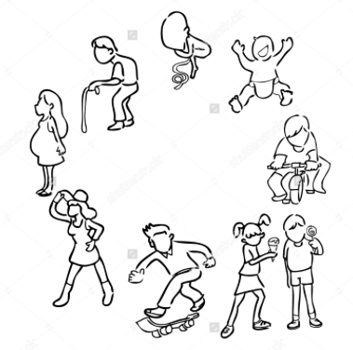
Conclusion
What does accessibility mean to you?
(The Accessible Icon Project, n.d.; World Health Organization, 2007; Shuttershock, n.d)
Notes:
So thinking back to the beginning of our presentation when we proposed the question of “ what does accessibility mean to you?” Your thoughts may have gone to the wheelchair and feature for a wheelchair users. We hope today that this presentation has expanded your view on accessibility to not only include this (first picture) but maybe also this (find picture of older people) and maybe even this ( some other kind of picture)? Thank you

Slide 35
References
AARP Network of Age-Friendly Communities. (2014). Retrieved from http://www.aarpinternational.org/File%20Library/ Resources/AARPNetworkofAgeFriendlyCommunitiesBooklet.pdf.
American Occupational Therapy Association. (2014). Occupational therapy practice framework: Domain and process (3rd ed.). American Journal of Occupational Therapy, 68(Suppl.1), S1–S48.http://dx.doi.org/10.5014/ajot. 2014.682006
Ageing and the life-course: Towards an age-friendly world. (n.d.). Retrieved from http://www.who.int/
ageing/age-friendly-world/end/
Bendixen, R. M., Mann, W. C., & Tomita, M. (2005). The relationship of home range to functional status and cognitive status of frail elders. Physical & Occupational Therapy in Geriatrics, 23(1), 43- 62. doi: 10.1080/ J148v23n02_03
Borrie, E., Crenshaw, J., Jasinski, N., Rosenblum, R., & Vandervort, M. (2015, March). Ithaca business owners and managers’ perceptions of the accessibility of their facilities. In D. Long (Chair), Ithaca College Occupational Therapy Research Colloquium. Symposium conducted at the meeting of Ithaca College Occupational Therapy Department, Ithaca, NY

Slide 36
Clarke, P., & Gallagher, N. A. (2013). Optimizing mobility in later life: The role of the urban built environment for older adults aging in place. Journal of Urban Health, 90(6), 997-1009.
Horn, L. (2012). An assessment of the needs of Tompkins County residents sixty years of age and older. Tompkins County Office for the Aging. Retrieved from: http://www.tompkinscountyny.gov/files/cofa/ Surveys_Facts/documents/2012_Assessment_Final_9-24-12.pdf
Ithaca, New York population: Census 2010 and 2000 interactive map, demographics, statistics, quick Facts. (n.d.). Retrieved from http://censusviewer.com/city/NY/Ithaca
Krueger, R.R. (1994). Focus groups: A practical guide for applied research. Newbury Park, CA: Sage Publications.
Shuttershock. (n.d). People growth circle life span. [Online image]. Retrieved from https://www.shutterstock.com/ image-vector/people-growth-circle-life-span-cartoon-242162647
RAMPS. (n.d.). Wood ramps. [Online image]. Retrieved from http://www.ramps.org/ramps-for-homes.htm
Rosenberg, D. E., Huang, D. L., Simonovich, S. D., & Belza, B. (2012). Outdoor built environment barriers and facilitators to activity among midlife and older adults with mobility disabilities. The Gerontologist. doi: 10.1093/geront/gns119
Notes:
Kielhofner, G. (2006). Research in occupational therapy: Methods of inquiry for enhancing practice. FA Davis.

Slide 37
Spinlife. (nd). Lightweight expediciton w/12” rear wheels [Online Image]]. Retrieved from http:// www.spinlife.com/Drive-Medical-Lightweight-Expedition-w/12-Rear-Wheels-Lightweight- TransportWheelchair/spec.cfm?productID=95340&adv=googlepla&utm_medium=CSE&utm_ter m= %7Bkeyword%7D%7Bmatchtype%7D&utm_campaign=%7Bcampaign %7D&utm_source=googlepla&default=1
The Accessible Icon Project. (n.d.). Use the icon [Online Image]. Retrieved from http://accessibleicon.org
The Growth of the U.S. Aging Population. (2016). Retrieved from http://www.seniorcare.com/
featured/aging-america/
World Health Organization. (2007). Global age friendly cities: A guide. Aging and Life Course, Family and Community Health. Retrieved from http://www.who.int/ageing/publications/ Global_age_friendly_cities_Guide_English.pdf?ua=1
Job Accommodation Network. (n.d.). The american with disabilities act glossary of terms. Retrieved from https:// askjan.org/links/adaglossary.htm
Notes:
Kielhofner, G. (2006). Research in occupational therapy: Methods of inquiry for enhancing practice. FA Davis.

